Slide 1
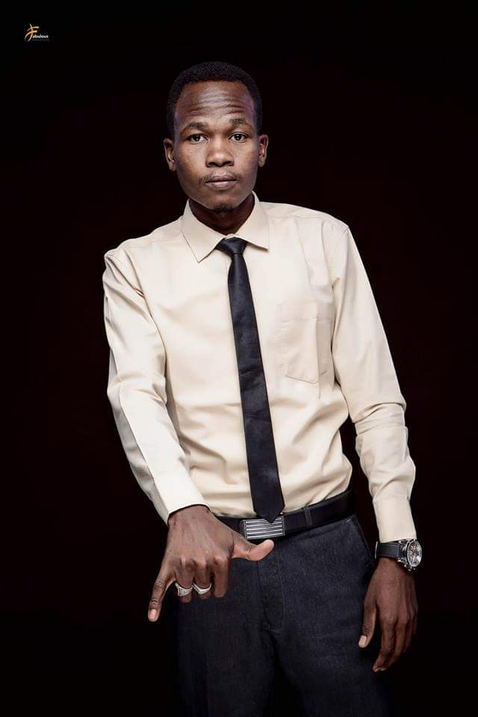
Monier Mohamed
“Hard although it may seem, you can do it. Learning English language is fun, so don't you ever dare to surrender!”

Slide 2
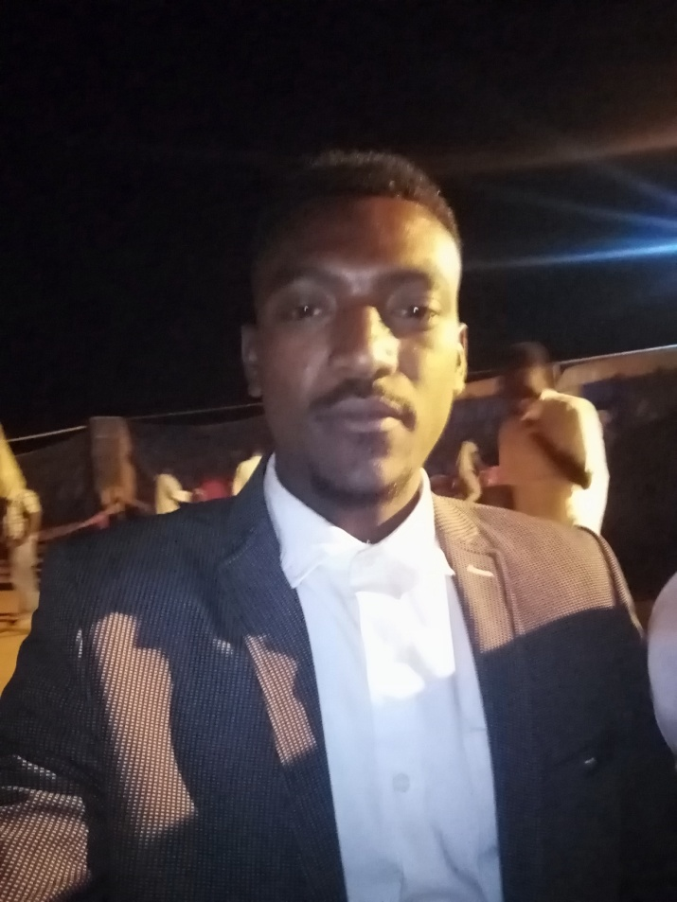
Yasser Mohammed
“Stay home, stay safe”

Slide 3
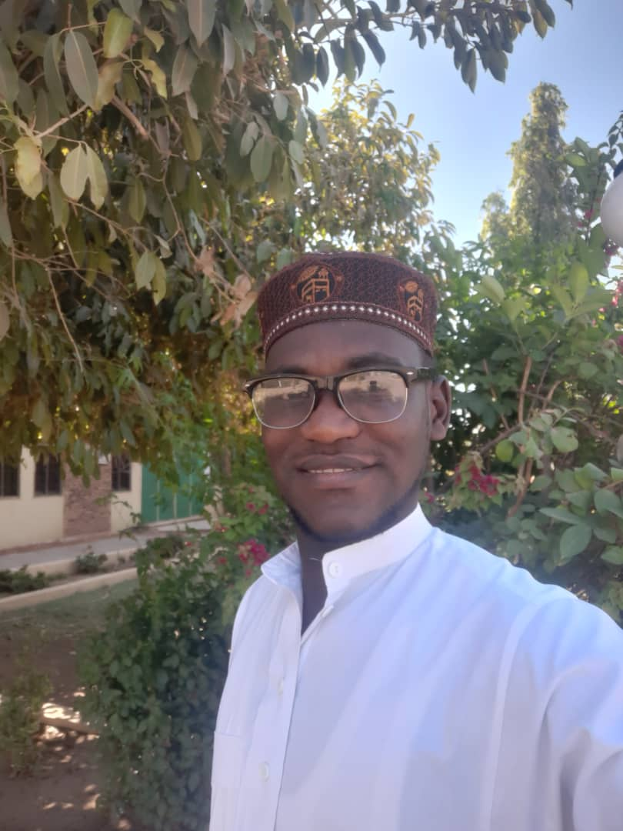
Atalemwa Said
“Education is Life dear brothers and sisters. Remember success has a simple formula. Do your best, people my like it.”

Slide 4
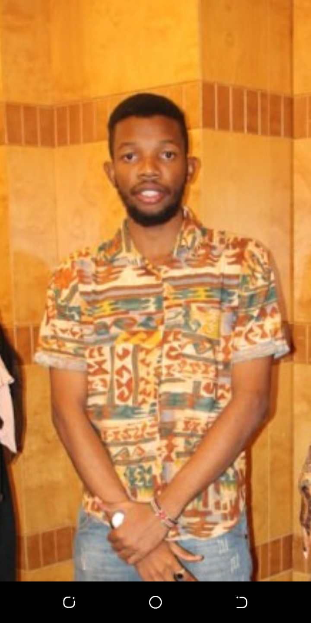
Mzee Omar
“Knowing is not enough, we must apply. Willing is not enough, we must do.”

Slide 5
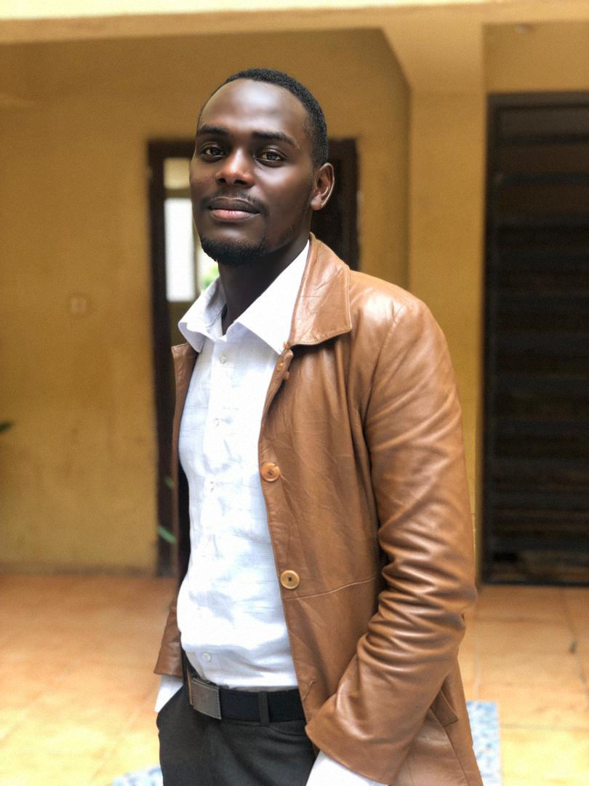
Agaba Sharif
“My beloved ones learners are earners. Let's always keep learning”

Slide 6
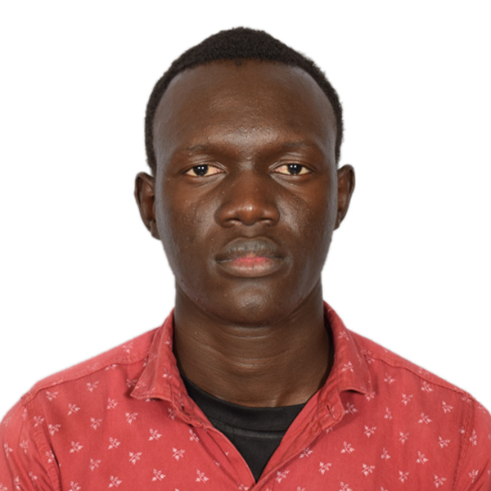
Alfred Mawurnyiin
“One language sets you on the corridor for life. Two languages open every door along the way”

Slide 7
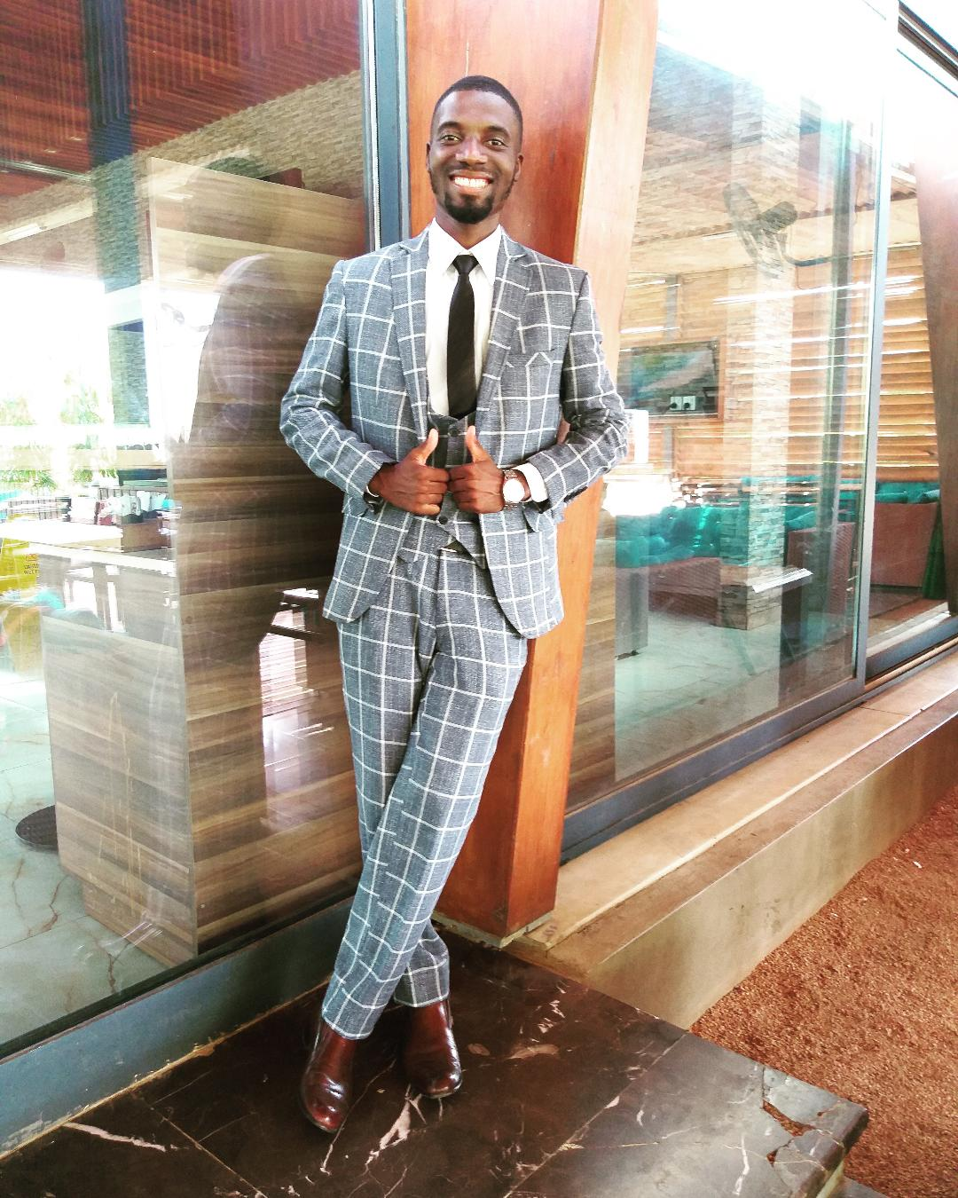
Dumisan Mussa
“Follow your path. Don’t blindly follow what others are doing.”

Slide 8
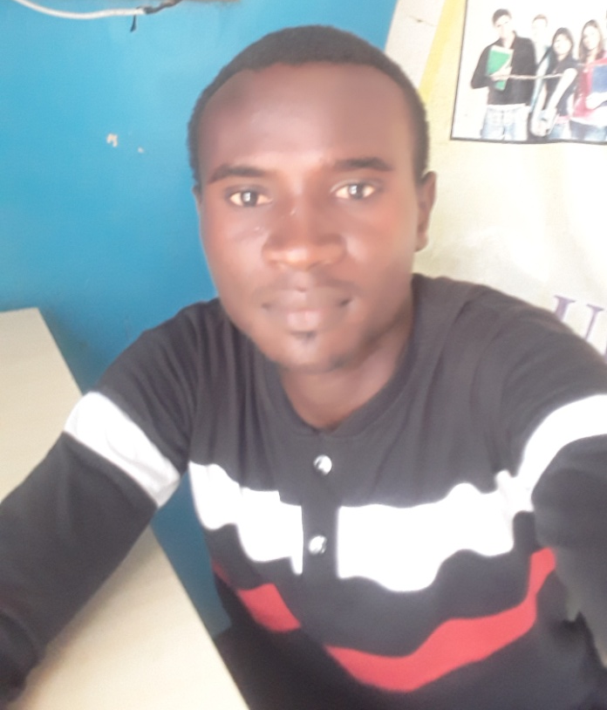
Moussa Ibrahim
“Keep learning and stay positive in in a time of uncertainty.”

Slide 9
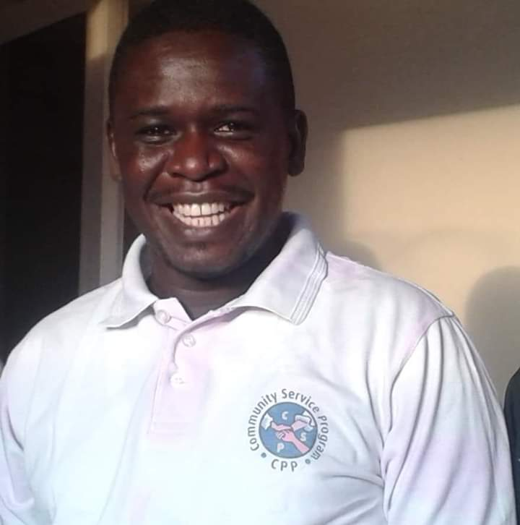
Samuel Nicola
“Hi. I am your English teacher, helping you to become a better speaker.”

Slide 10

Ayub Shaaban
“Education is simply the soul of a society as it passes from one generation to another.”

Slide 11
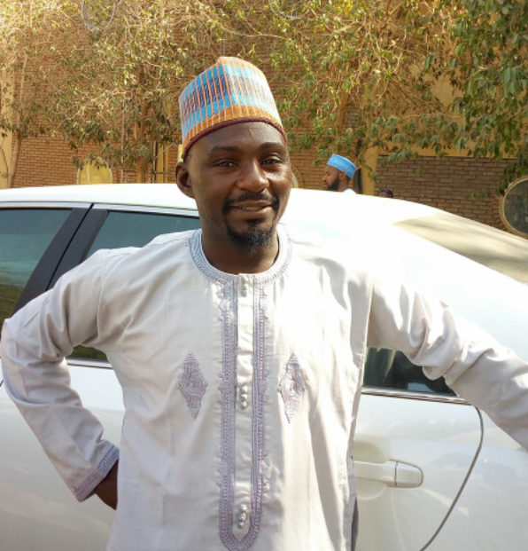
Ali Shehu
“Learning is the future to our lives”

Slide 12
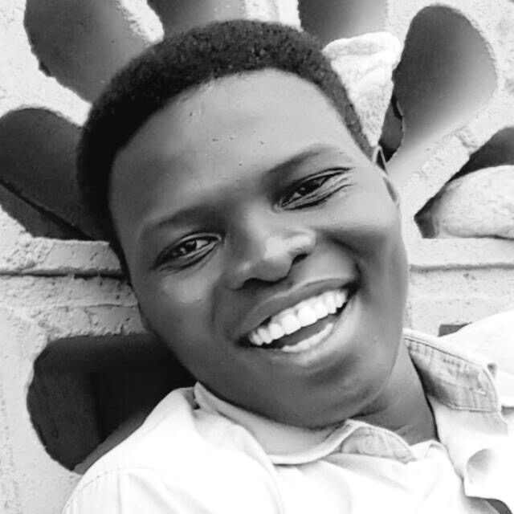
Badrelden Adam Omer
“It’s not the end, but everything has its time”

Slide 13
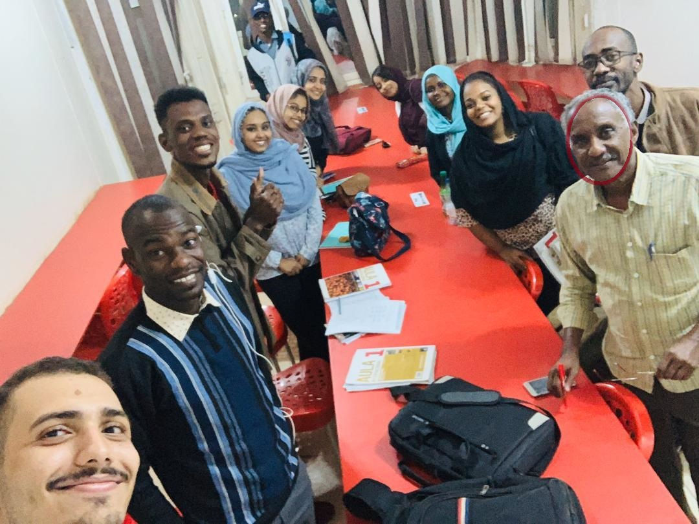
Mohamed Nagieb
“Quien come y canta algo le falta”

Slide 14
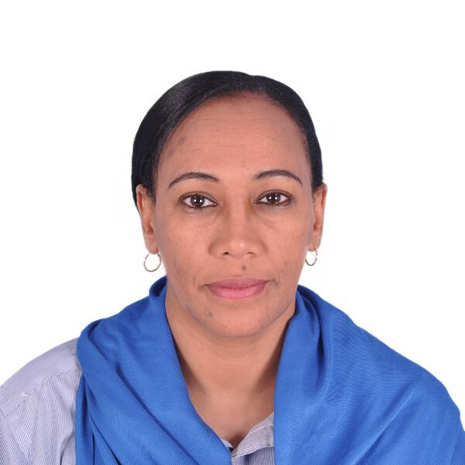
Nahla Gafer
“Chi disprezza vuol comprare”

Slide 15
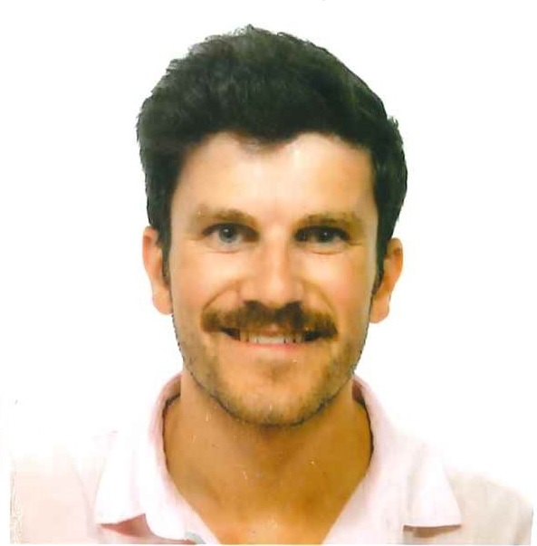
Jaime Ferri Vilas
“El que lee mucho y anda mucho ve mucho y sabe mucho”

Slide 16
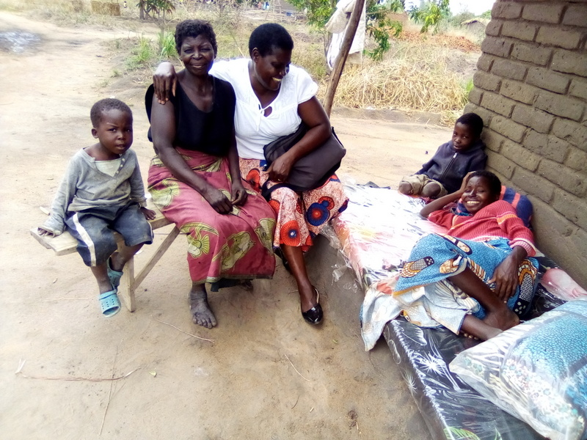
Catherine Nwangi
“Hope does not disappoint, because the love of God has been poured out into our hearts through the Holy Spirit.”

Slide 17
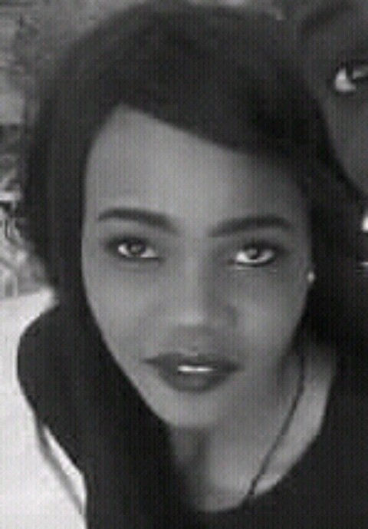
Salwa Ibrahim
“The early bird catches the worm”

Slide 18
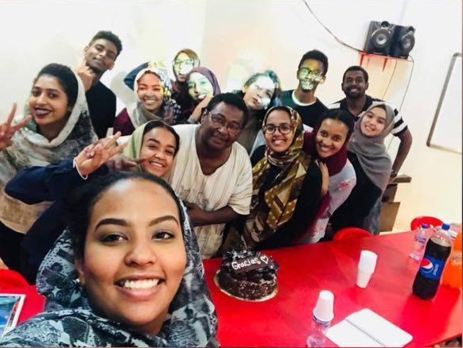
Yassir Hussein
“Ten paciencia. No te apresures. Hay anos que hacen preguntas y anos que dan las respuestas. No todo es ya, ni ahora ... la vida toma su tiempo.”

Slide 19
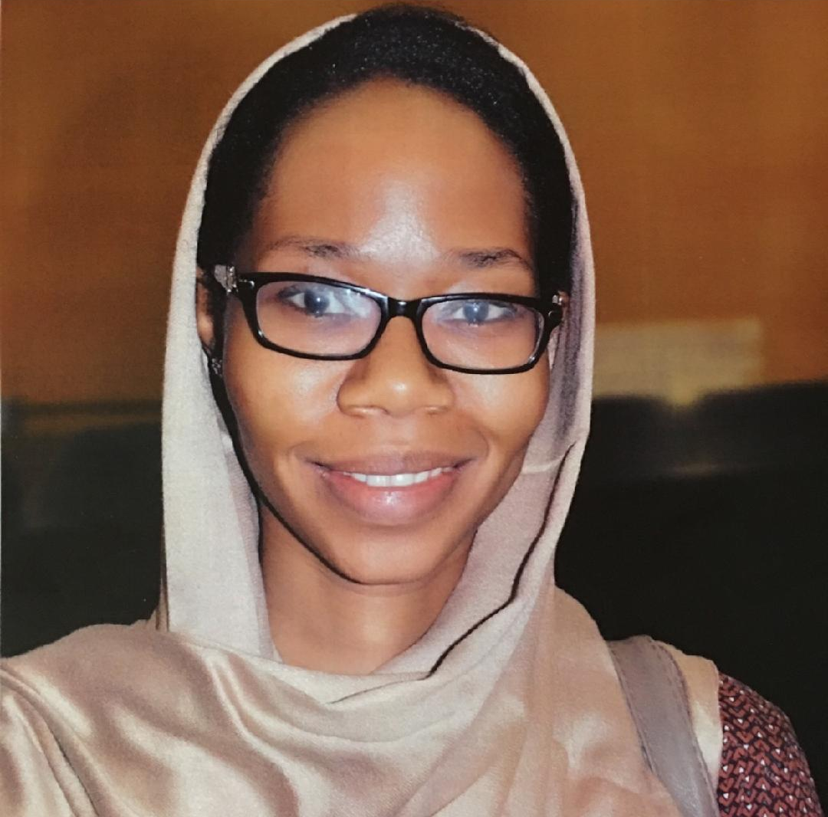
Shaima Siddig
“It is never too late”

